Slide 1

Pbl Project
FLIEGEN-TOURIST SPOT FINDER

Slide 2


Agenda
Introduction​
Objective
Glimpse
Summary​

Slide 3
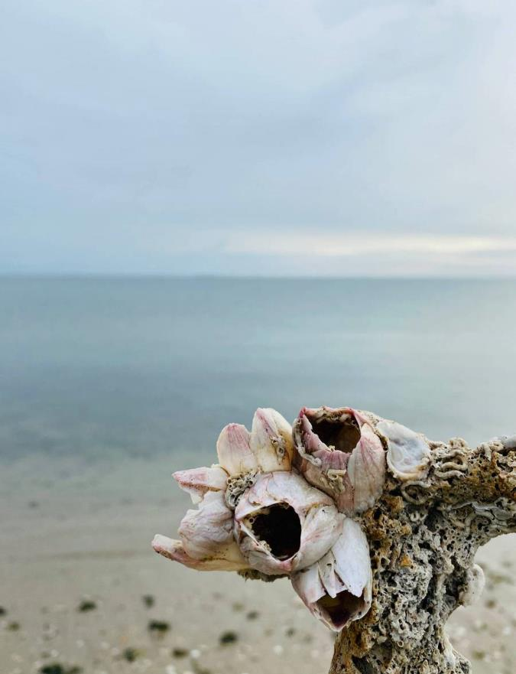
Introduction
Travelling and roaming around is in the top of bucket list of most of the people in the world. But when it comes in real, people are not able to decide the best spots or places to visit. This was the main inspiration of this project as we wanted to help people to get the list of best places in one tap and help them plan their tour efficiently.

Slide 4

Objectives

Slide 5
1.Making tourist places easily searchable and accessible.
2.Showing weather conditions to make planning feasible.
3.Recommending spots according to user interest.
4.Website designed such that, anyone can use it.
5.Along with showing the location, we also help guiding the traveler to reach that spot.

Slide 6


Slide 7








Our Team
Takuma Hayashi​
Mirjam Nilsson​
Flora Berggren​​
Rajesh Santoshi​
President​
Chief Executive Officer​
Chief Operations Officer​
VP Marketing​
Graham Barnes
Rowan Murphy​
Elizabeth Moore​
Robin Kline​
VP Product​
SEO Strategist​
Product Designer​
Content Developer​

Slide 9
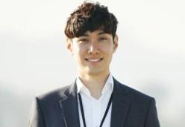



Our Team
Takuma Hayashi​​
Mirjam Nilsson​​
President​
Chief Executive Officer​
Flora Berggren​​
Rajesh Santoshi​
Chief Operations Officer​
VP Marketing​

Slide 10
Plan For Product Launch
Planning
Marketing
Design
Strategy
Launch
Synergize scalable
e-commerce
Disseminate standardized metrics
Coordinate
e-business applications
Foster holistically superior methodologies
Deploy strategic networks with compelling
e-business needs

Slide 11
Timeline
Sep 20xx
Jan 20xx
May 20xx
Synergize scalable
e-commerce
Coordinate e-business applications
Deploy strategic networks with compelling e-business needs
Nov 20xx
Mar 20xx
Disseminate standardized metrics
Foster holistically superior methodologies

Slide 12
Areas of Focus
B2B market scenarios​
Cloud-based opportunities​
Develop winning strategies to keep ahead of the competition​
Capitalize on low hanging fruit to identify a ballpark value​
Visualize customer directed convergence​
Iterative approaches to corporate strategy​
Establish a management framework from the inside​

Slide 13
How we get there
ROI​
Niche markets​
Supply chains​
Envision multimedia-based expertise and cross-media growth strategies​
Visualize quality intellectual capital​
Engage worldwide methodologies with web-enabled technologies​
Pursue scalable customer service through sustainable strategies​
Engage top-line web services with cutting-edge deliverables​
Cultivate one-to-one customer service with robust ideas​
Maximize timely deliverables for real-time schemas​

Slide 14

Summary
At Contoso, we believe in giving 110%. By using our next-generation data architecture, we help organizations virtually manage agile workflows. We thrive because of our market knowledge and great team behind our product. As our CEO says, "Efficiencies will come from proactively transforming how we do business."​

Slide 15


Thank you
Mirjam Nilsson​​
mirjam@contoso.com​
www.contoso.com​

